Slide 1
TRUST THE PROCESS
POWERING THROUGH THE 80/20 RULE

Slide 2
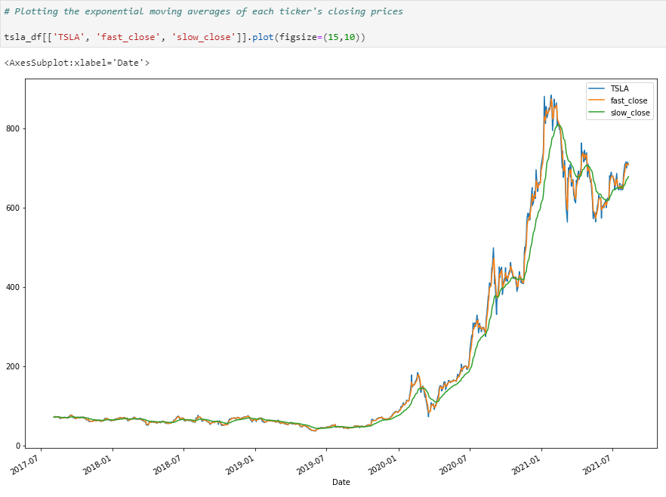
PROJECT OUTLINE
MOTIVATION AND SUMMARY
WHAT WE LEARNED - INTRO
DATA SOURCES
NewsAPI, the Guardian, MediaStack
Wikipedia Views
Y Finance
DATA CLEANUP + SIGNALS
Assessing the value of the data sources
Cleaning news and media data
Bollinger Bands
TRAINING THE DATA + MODELS
LSTM
Random Forest Model
EVALUATING THE MODELS
LSTM
Random Forest Model
WHAT WE LEARNED - CLOSING

Slide 3
MOTIVATION AND SUMMARY
In this project, we initially hoped to leverage some of our members’ niche knowledge to create a number of predictive trading models using NLP and sentiment analysis for one set of models, and LSTM and Random Forest models for the other, then compare them.
The goal was to determine first, if there were trends in the news/media data that could be used as predictors, and if those results were superior to other methods that relied on daily closing prices and % changes.

Slide 4
WHAT WE LEARNED
80% of the results, come from 20% of the effort.
– Pareto’s Law
The biggest lesson we learned is that 80% of our ideas seem to be bad ideas– but that’s OK. Pareto’s law applies here and shows us that 80% of our best results will come from 20% of our efforts. We’re just getting through the 80% of the useless efforts now. We also discovered two other laws during this project:
Anything that can go wrong, will go wrong.
– Murphy’s Law
Thinly sliced cabbage.
– Cole’s Law

Slide 5
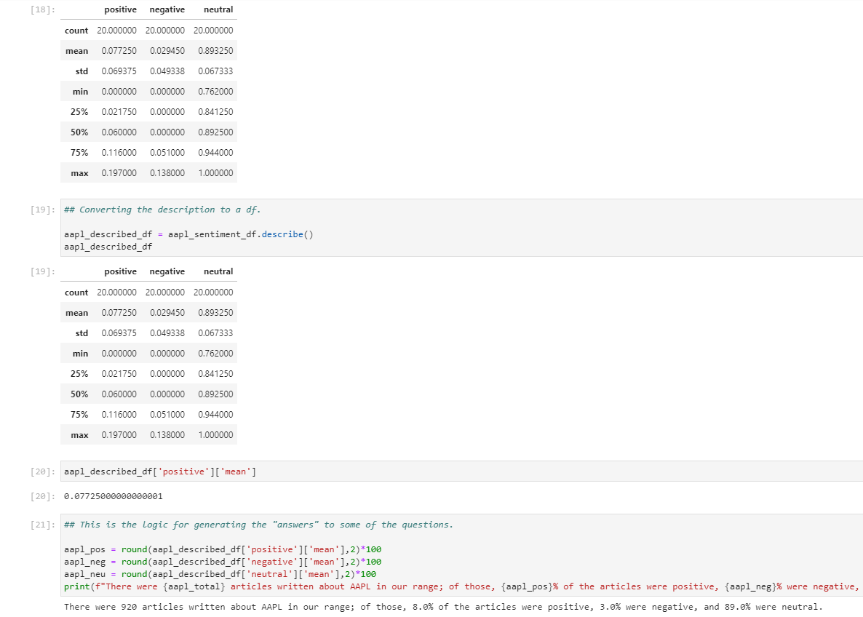
DATA SOURCES 1: NEWSAPI
Since we had some familiarity with the NewsAPI service already, we turned to it first to see what we could get from it. The first limitation we found was that we could only go back 100 trading days– but we thought that would be good enough to see if there was some correlation between positive sentiment and closing price that we could use to educate our predictive models. This is where we hit our first major block.
NewsAPI, while capable of “going back” 100 days, would only serve us 20 articles to run sentiment analysis on, which wasn’t enough data to produce meaningful results (especially with companies like Ford or Tesla, which often had more than 20 articles published about them in a single given day).
We thought we could salvage some of our efforts here by setting up the logic with an easy “find and replace” structure that could serve “today’s sentiment” on any given ticker.

Slide 6
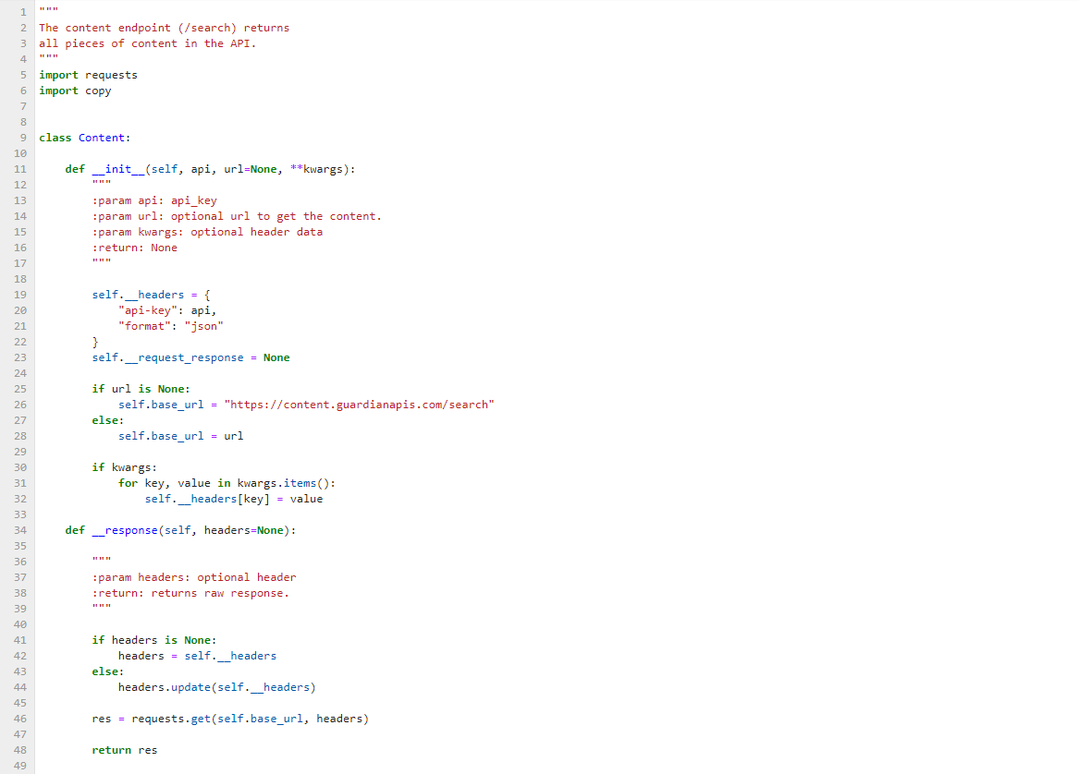
DATA SOURCES 2: THE GUARDIAN
After realizing that the free NewsAPI results wouldn’t be useful for our purposes, we searched for other APIs that would give us similar results, and one of these was the UK paper, The Guardian.
In addition to the usual registering for an API key and building that into the notebook that we’d done in class, we had to download and configure a .py file to be able to import The Guardian’s results into our code.
You can find some of that documentation below:
Guardian-API-Python (GitHub)
The Guardian Open Platform Docs (Official)
In the end, despite the fact that we could “go back” as far as we wanted to, we were still limited by the number of results we could pull at any given time and decided to move on to other sources.

Slide 7
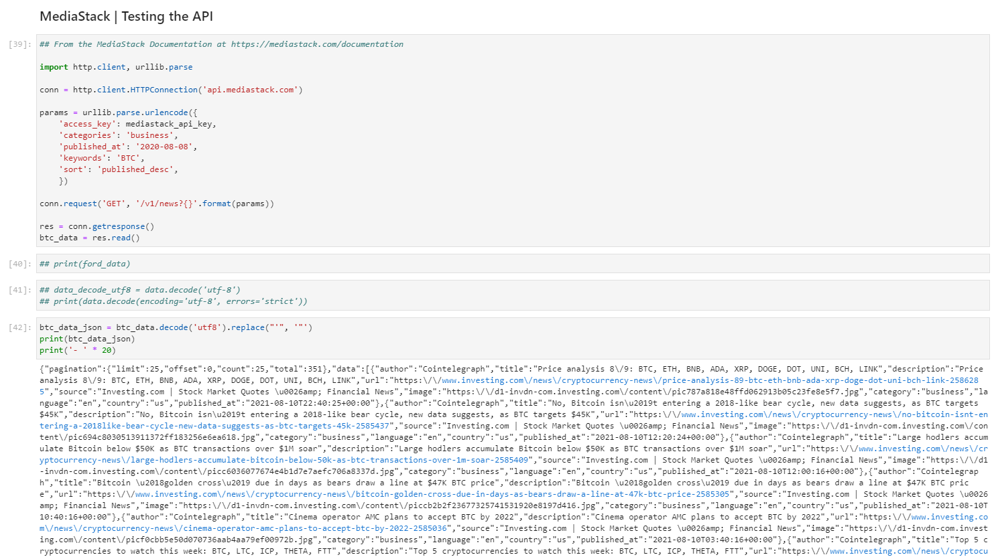
DATA SOURCES 3: MEDIASTACK
Our third attempt at sourcing usable natural language data, MediaStack seemed initially promising, allowing us to search articles from a number of data sources and filtering those by keyword, publication date, even down to the byline, which would– in theory– allow us to weigh the sentiment of certain industry “experts” over others.
The first hurdle we cam across was the way in which the data was presented– it looked like JSON, but it wasn’t JSON, and required a fair bit of processing in order to make it usable.
The second was an issue of “pagination”. Similar to NewsAPI and The Guardian, MediaStack limited a given result to the “first twenty” articles called. Again: an interesting exercise, but not enough information to be considered useful for our project.

Slide 8
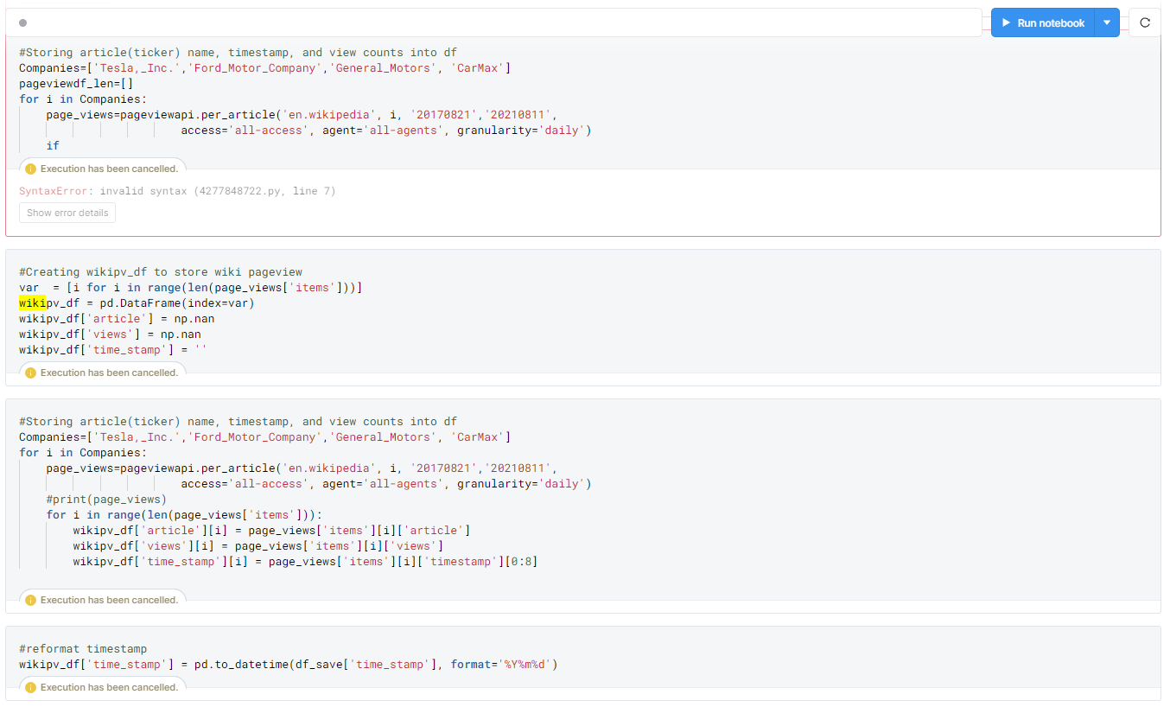
DATA SOURCES 4: WIKIPEDIA
After three attempts at finding article data that was useful, we pivoted and decided to track pageviews on WikiPedia. We believed this would be similar to Google Search trends, with greater interest in learning about a given company translating to positive movement in that stock’s closing price.
The data was readily available and we were able to successfully integrate it into our code on different models and notebooks.

Slide 9
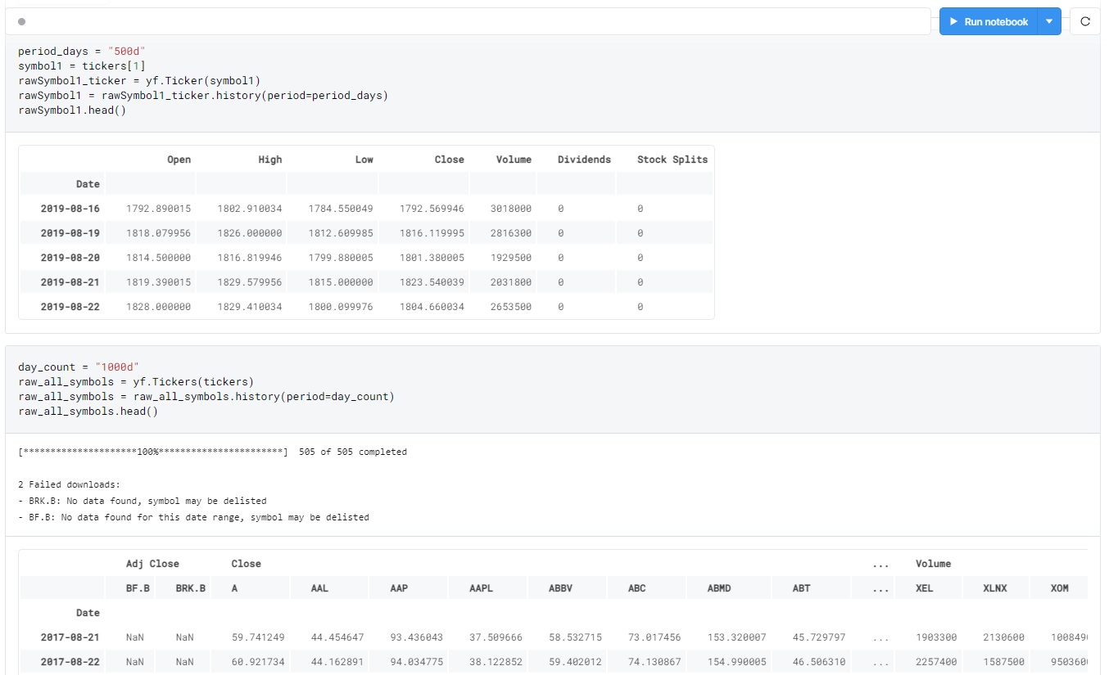
DATA SOURCES 5: Y FINANCE
We used the y_finance library to pull 500d and 1000d of trading data on the S&P 500 stocks, then converted it into a .csv file so we could more easily manipulate the stock data.

Slide 10
DATA CLEANUP AND SIGNALS
1 ASSESSING THE VALUE OF THE DATA SOURCES
We already covered some of the shortcomings of the news and natural language APIs, which– while seemingly valuable– were so limited in scope in their “free” versions as to be mostly unusable. Still, reading in and cleaning the data was valuable repetition of skills, and is worth sharing in this section.
The S&P500 closing price history was available as a .csv file. That proved valuable and useful for our final models, as it gave us enough history to start to pull signal from noise in our predictive models.

Slide 11
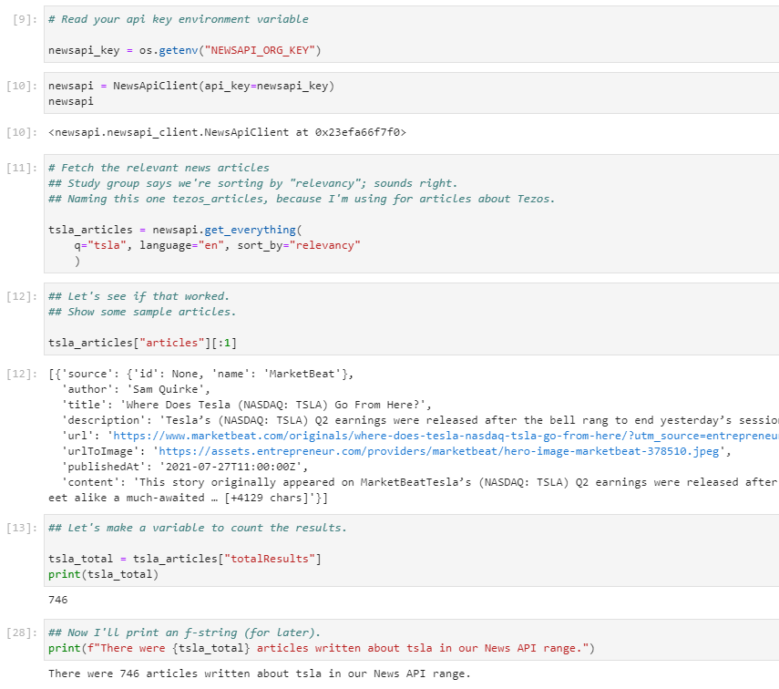
DATA CLEANUP AND SIGNALS
2 CLEANING THE NEWSAPI DATA (1:2)
For the NewsAPI section, we pulled in the data using the same methods we used during our crypto sentiment homework.
In the image at right, you’ll see us pull the total number of articles available in our “100 days”. This was a later addition, after we had pivoted from a complex sentiment data to a more simple, volume data approach.

Slide 12
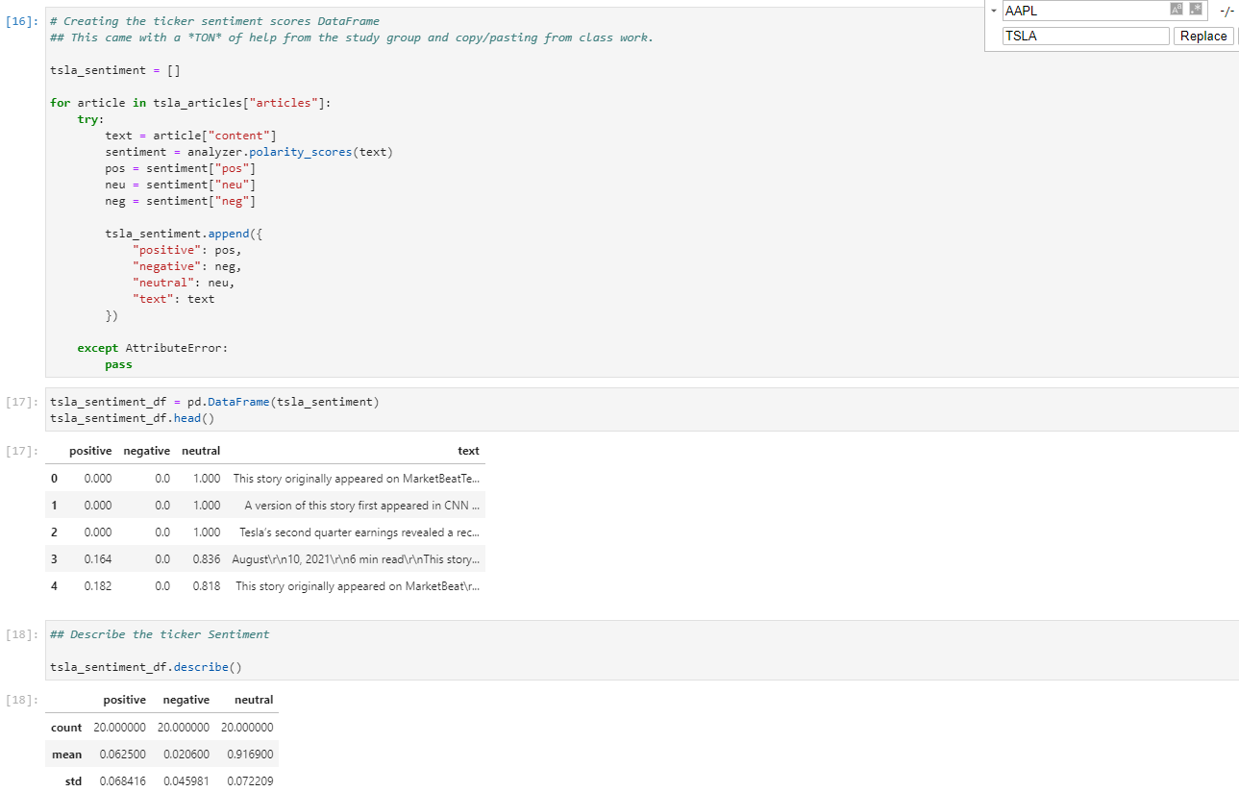
DATA CLEANUP AND SIGNALS
2 CLEANING THE NEWSAPI DATA (2:2)
At right, you can see how we used the same sort of polarity_scores analyzer from the homework, looking at the “standard” positive, negative, and neutral. As you read the code, it’s important to note two things in this figure:
There is no “niche knowledge” here, as we had already established we would have insufficient data to draw relevant conclusions.
The code is written in such a way that a “Replace All” command in the notebook would effectively generate a recent sentiment score for any stock ticker.

Slide 13
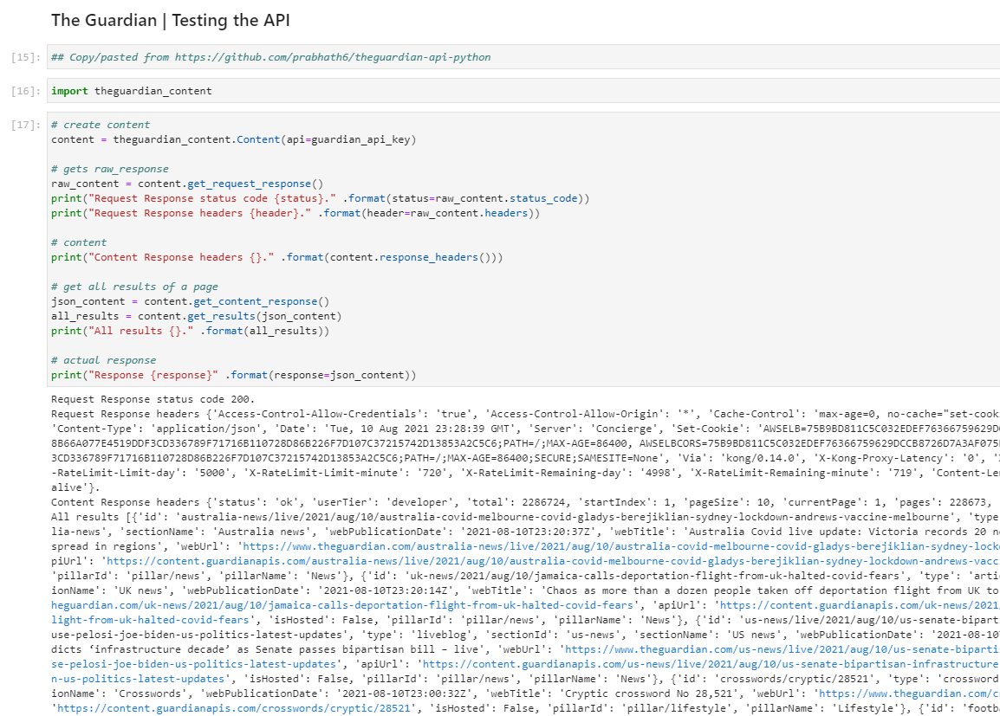
DATA CLEANUP AND SIGNALS
2 CLEANING THE GUARDIAN DATA (1:2)
After downloading the necessary .py files and importing theguardian_content library, we followed the instructions in the documentation and got our responses back in a JSON format.

Slide 14
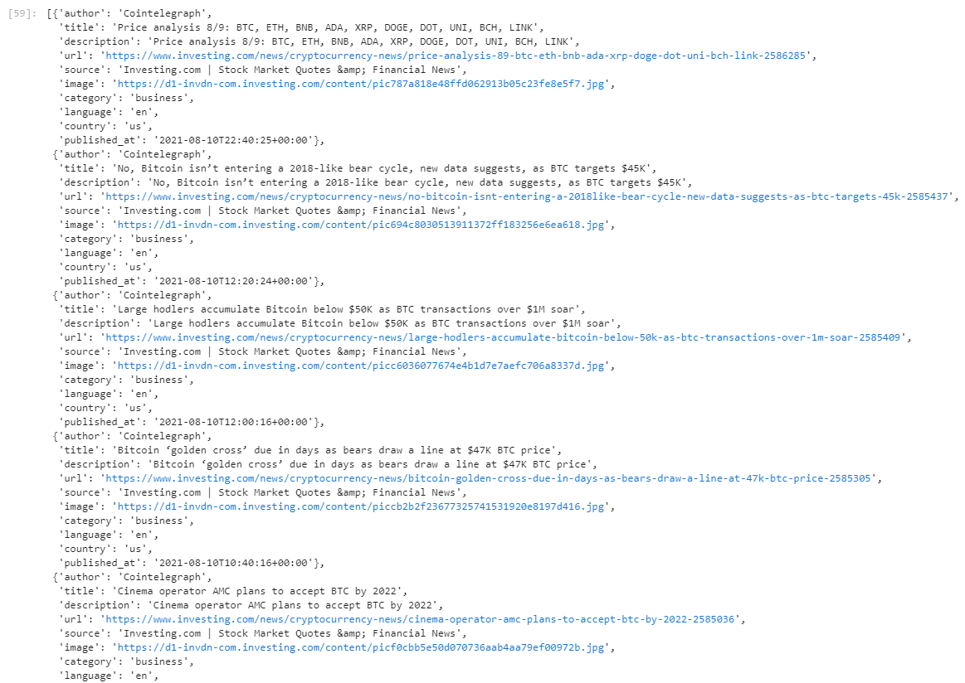
DATA CLEANUP AND SIGNALS
2 CLEANING THE GUARDIAN DATA (2:2)
We eventually got the data to pretty print using the dumps() method.
Because of the pagination issues, and the difficulty in ensuring that the environment could be duplicated by other users, we abandoned The Guardian API here.

Slide 15
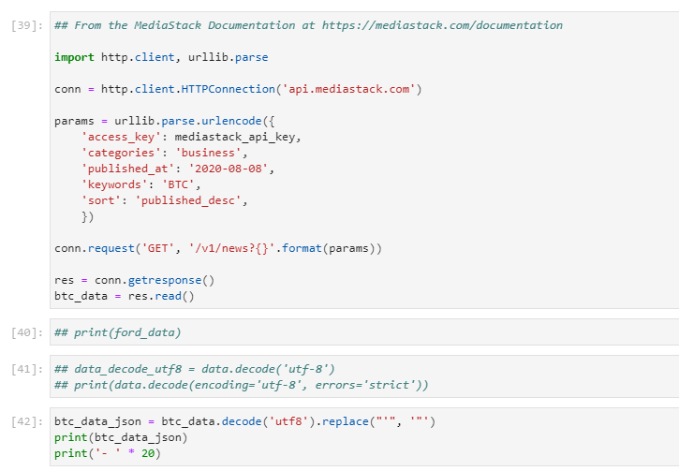
DATA CLEANUP AND SIGNALS
2 CLEANING THE MEDIASTACK DATA
The MediaStack documentation was incredibly thorough, and we were able to import the http.client, set the params, and get a response very easily.
The biggest challenge was that MediaStack’s results returned with apostrophes (‘) instead of quotation marks (“) which had to be replaced in the string in order to be recognized as JSON.

Slide 16
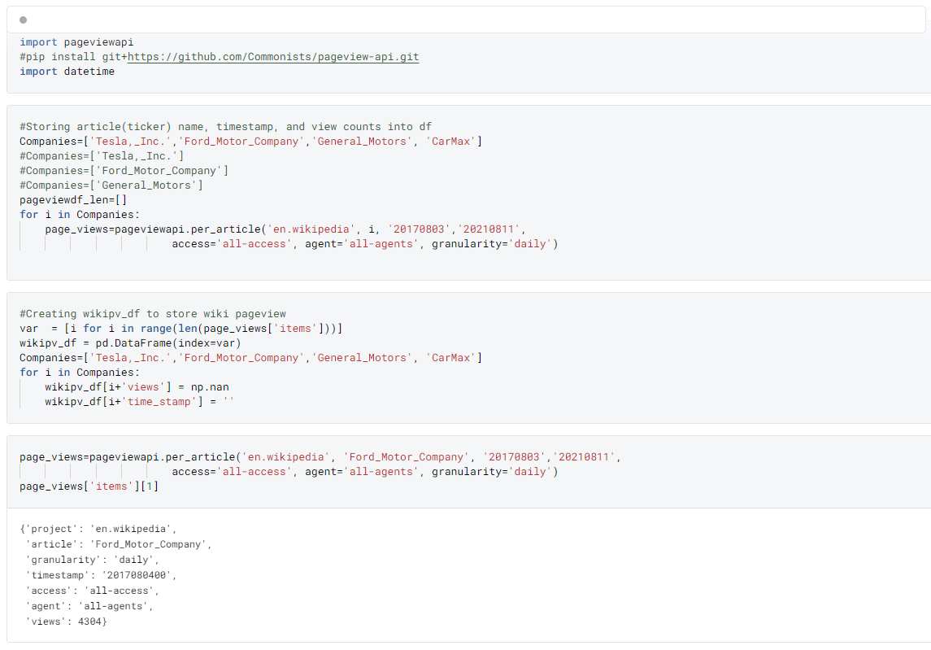
DATA CLEANUP AND SIGNALS
2 CLEANING THE WIKIPEDIA DATA
The Wikipedia views data was pretty straightforward, we created a df to store the pageviews with the granularity of the query set to “daily” and indexed by date.
From there we binned the views count and applied the standard scalar to use it as an indicator in our later predictive models.

Slide 17
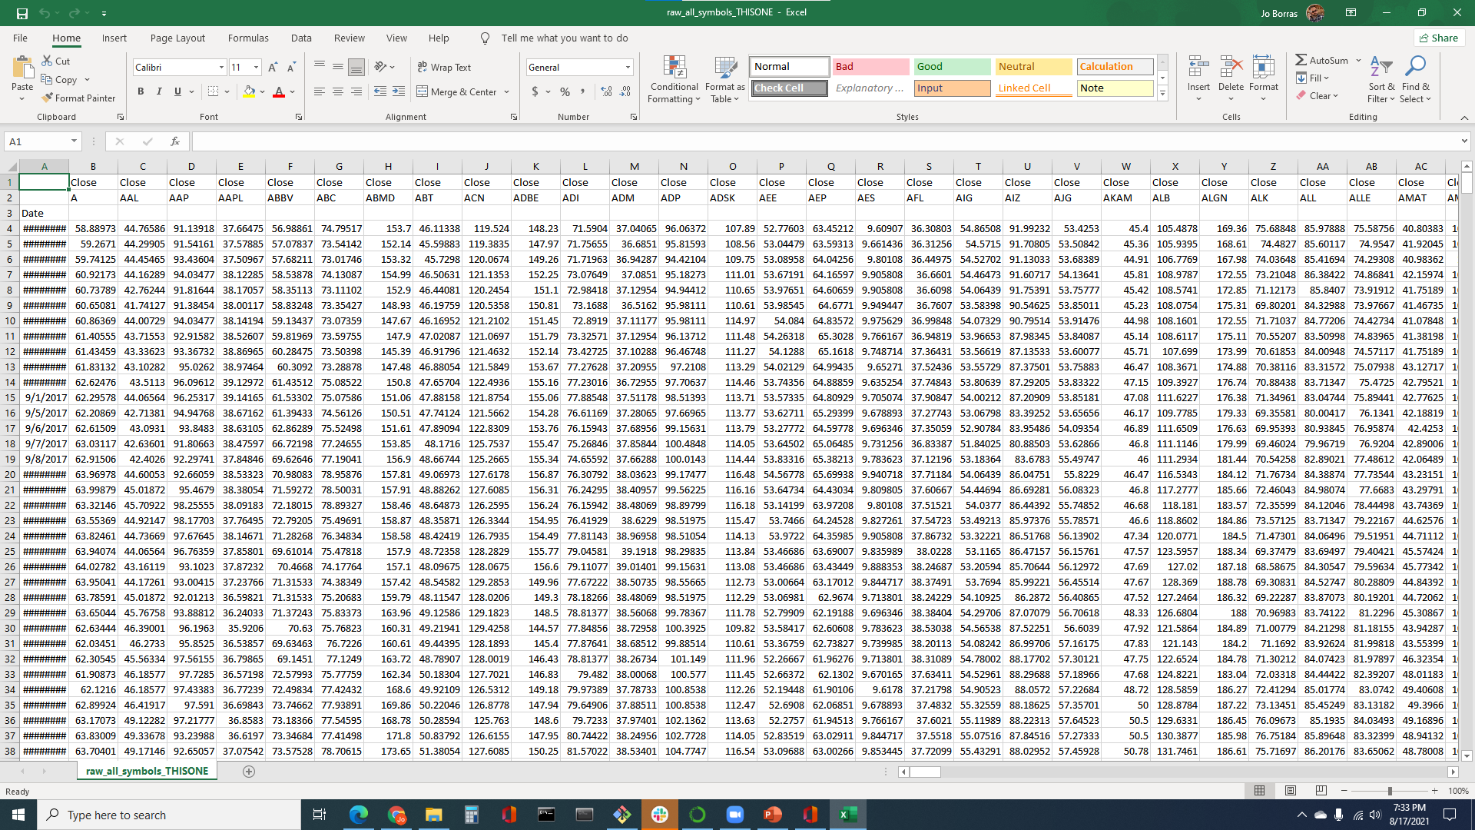

DATA CLEANUP AND SIGNALS
2 CLEANING THE S&P 500 DATA
We converted the y finance data to a .csv file (shown here, at right).
Early in the project we decided to focus on automotive stocks (specifically F, GM, KMX, and TSLA) so cleaning this data was a matter of dropping columns and replacing NaN values for TSLA (the first 15 trading days in our data) with a “0” value.

Slide 18
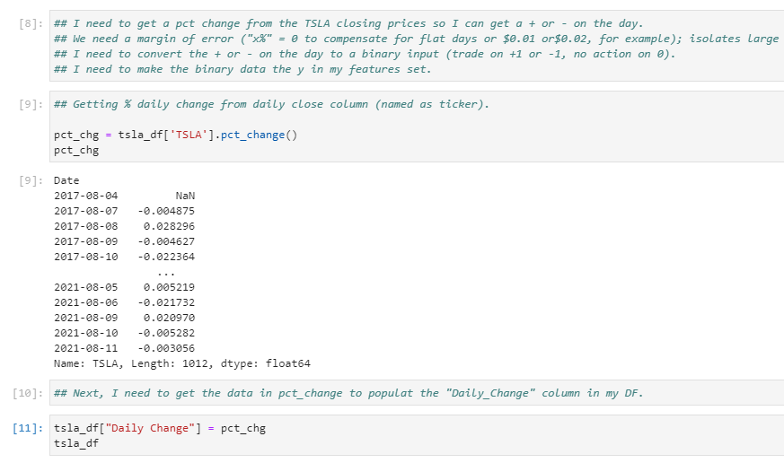
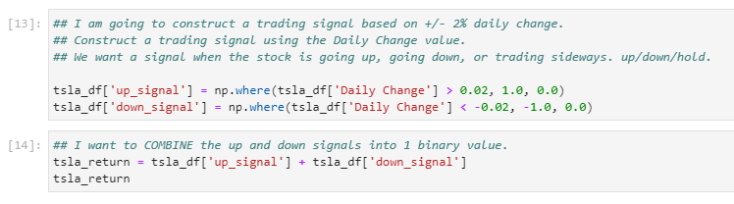
DATA CLEANUP AND SIGNALS
LOOKING FOR SIGNALS IN THE DATA (1:3)
We then isolated each ticker and created a pct_chg column using the daily close data. We decided that a positive swing of more than 2% should return a 1 signal, while a negative swing greater than 2% should return a -1 signal. 0 signals signified a hold, or “no signal”.
NOTE: the logic is written such that you could find and replace the ticker symbol and generate the same type of results quickly.

Slide 19
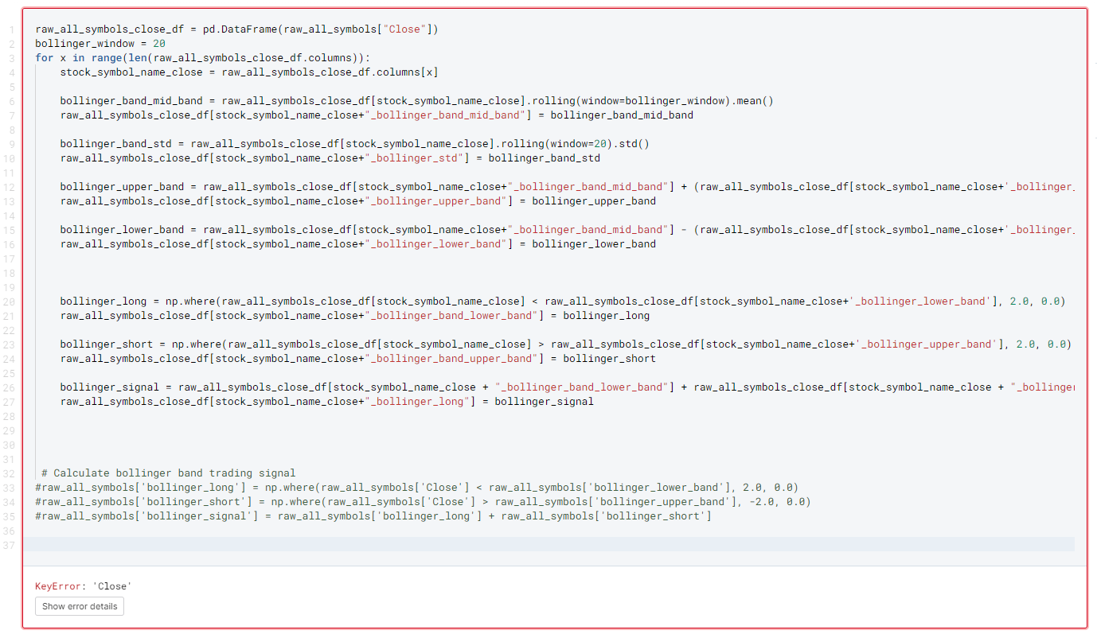
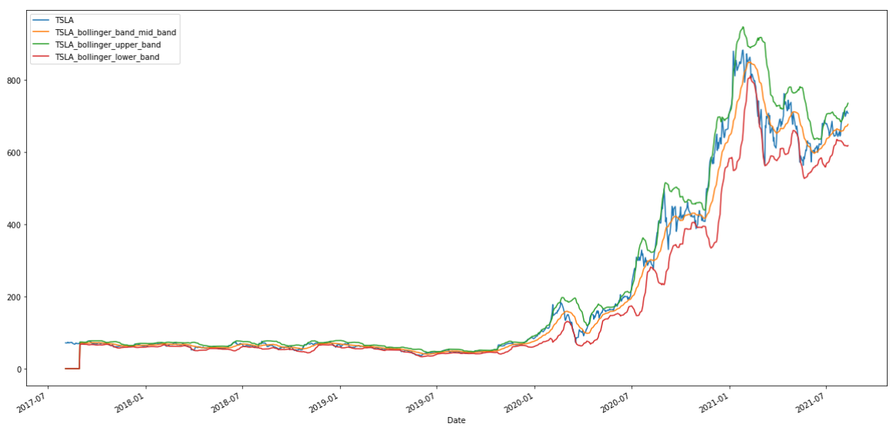
DATA CLEANUP AND SIGNALS
LOOKING FOR SIGNALS IN THE DATA (2:3)
For our next set of signals, we used Bollinger Bands representing two standard deviations above the 20 day moving average and two standard deviations below the 20 day moving average.
Our model created a signal whenever the actual closing price pierced the upper and lower Bollinger Bands our model signals a sell or buy signal depending on which band was pierced.

Slide 20
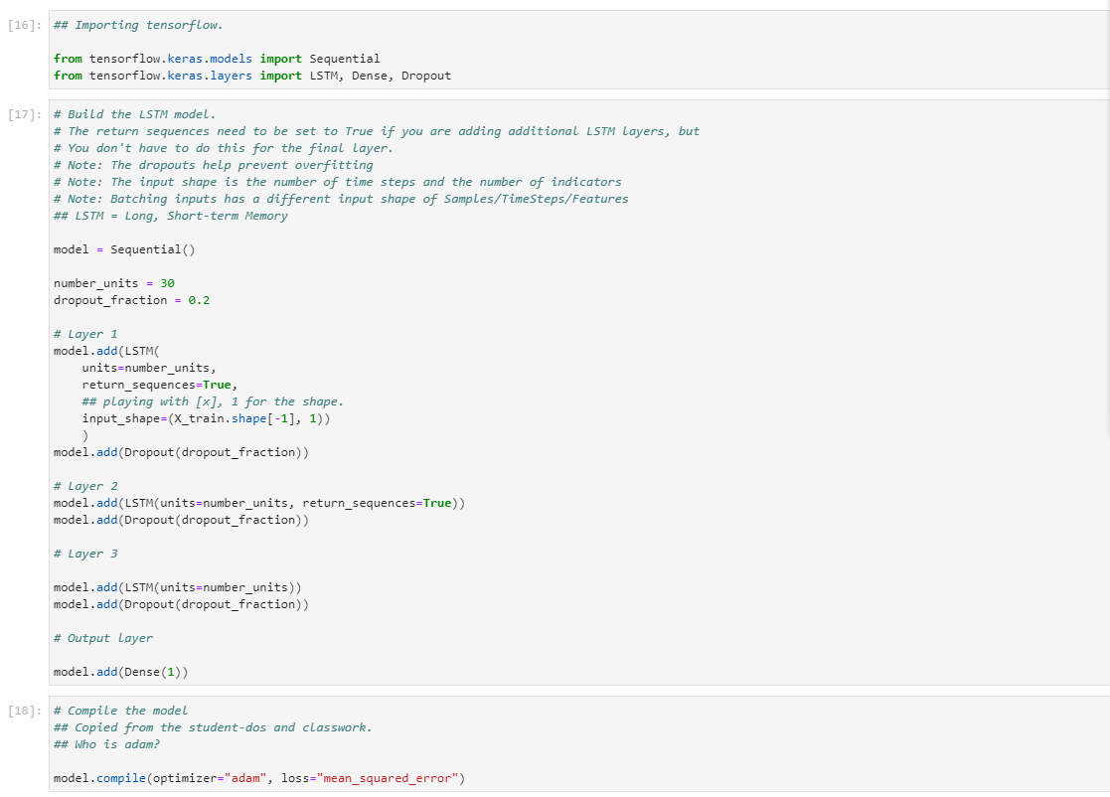
TRAINING THE DATA AND MODELS
LSTM MODEL (1:3)
We built the LSTM model out with each of the automotive stock tickers using the same “rinse and repeat” code blocks we went over in class.

Slide 21
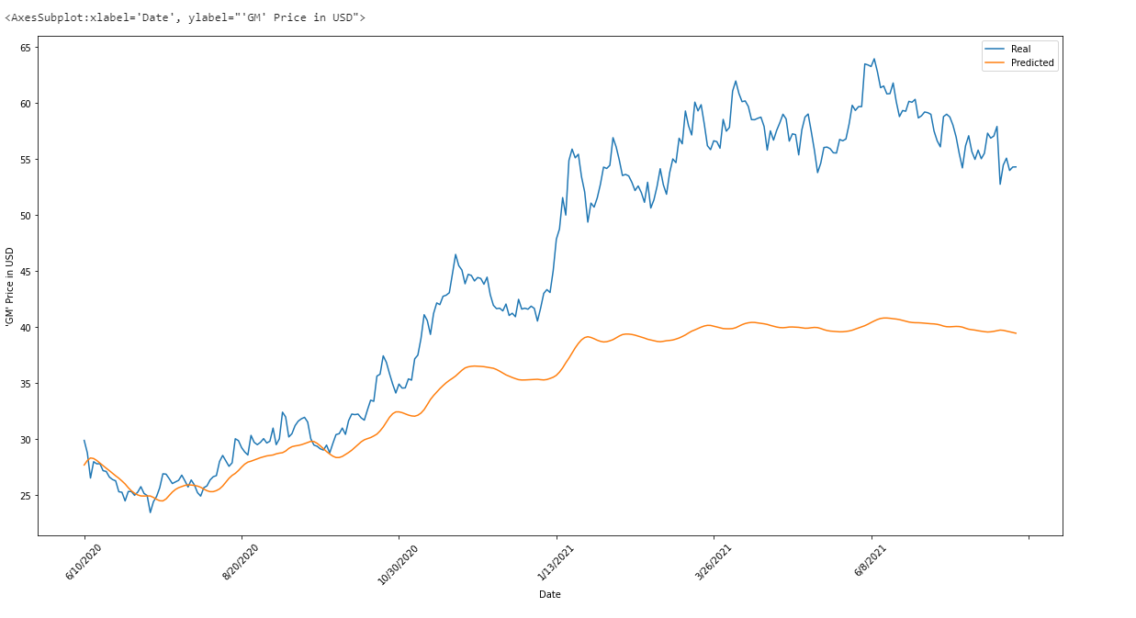
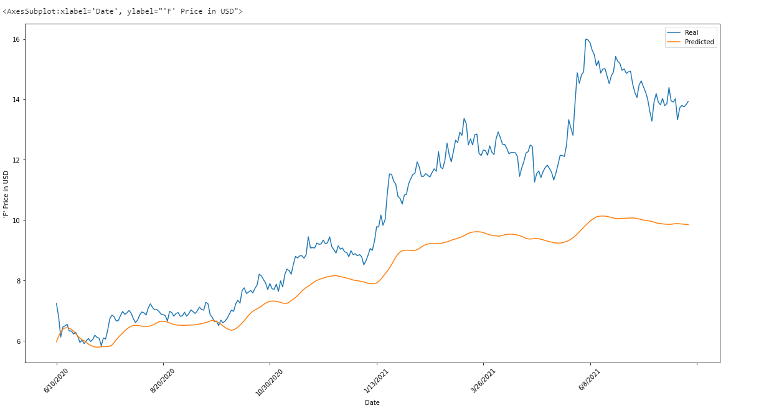
TRAINING THE DATA AND MODELS
LSTM MODEL (2:3)
The LSTM models “hugged” the real prices fairly well in the first six months before trailing behind– but they still followed the overall trend of the closing prices. Here you can see the GM and F stocks.

Slide 22
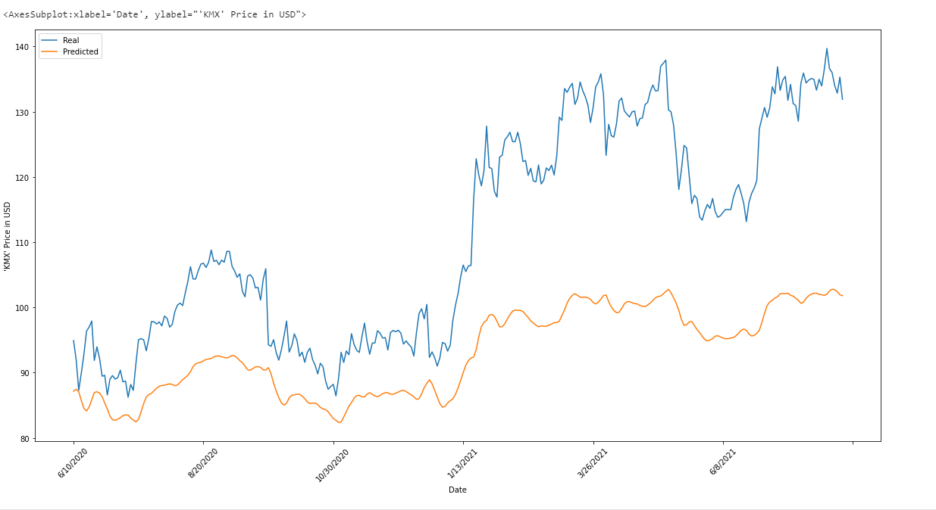
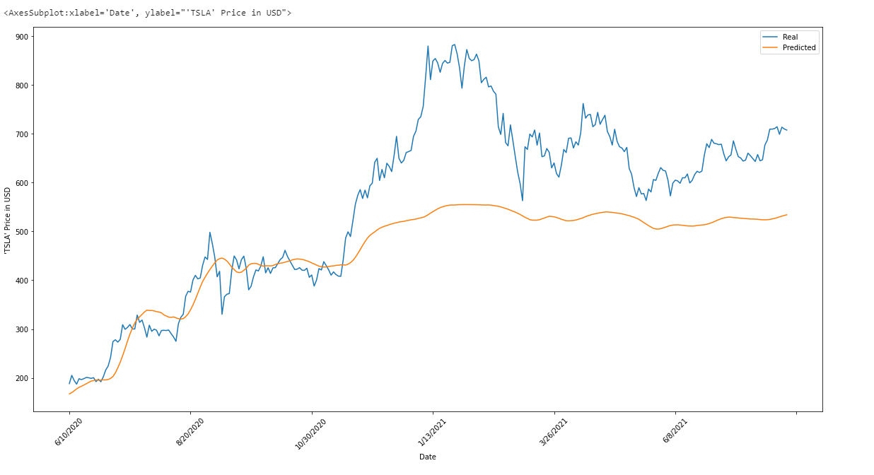
TRAINING THE DATA AND MODELS
LSTM MODEL (2:3)
The TSLA model was interesting, as changing the number of epochs and batch sizes run change the results dramatically. Again, it was very good for the first six months, but went “flat” during TSLA’s bull run between OCT20 and FEB21.

Slide 23
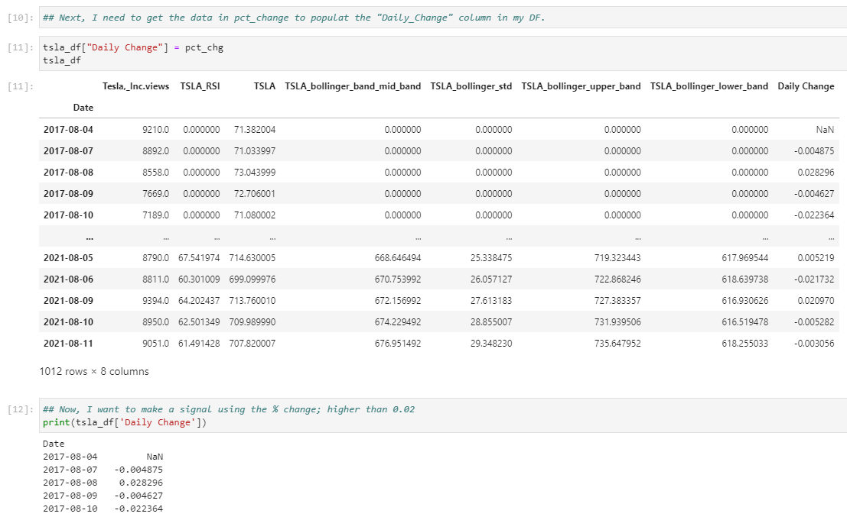
TRAINING THE DATA AND MODELS
RANDOM FOREST (1:8)
For the random forest model, we started with the whole of the S&P and with a regression strategy that used Bollinger bands and RSI to find over extended markets. We narrowed our focus to automotive stocks within the S&P with plans to add NLTK indicators later.

Slide 24
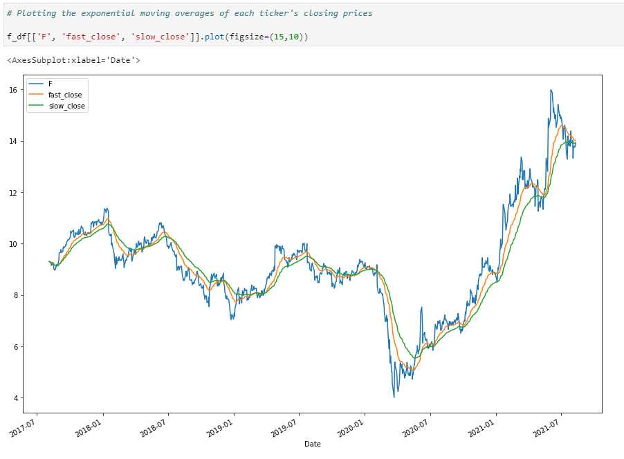
TRAINING THE DATA AND MODELS
RANDOM FOREST (2:8)
We used a 10 day and 20 day rolling average and converted the different data to binary for the up and down signals in our model. The resulting model was a bit slower than we would have liked, missing the “peak” of the late 2020-Feb. 2021 bull runs by about 10%– but still finishing “ahead”.
You can see the Ford (F) model, at right.

Slide 25
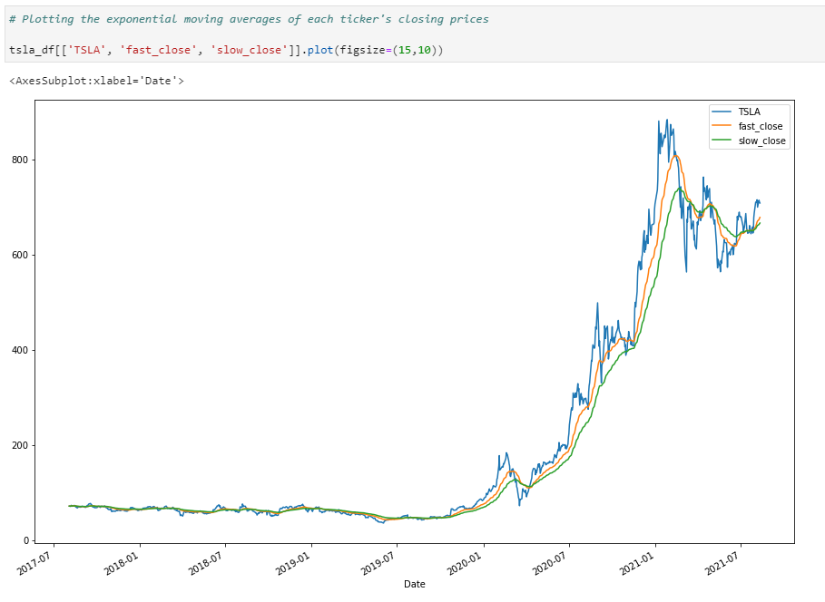
TRAINING THE DATA AND MODELS
RANDOM FOREST (3:8)
We saw a similar “delay” using this 10/20 day crossover method across all the stocks we used. You can see the Tesla (TSLA) model, at right.

Slide 26
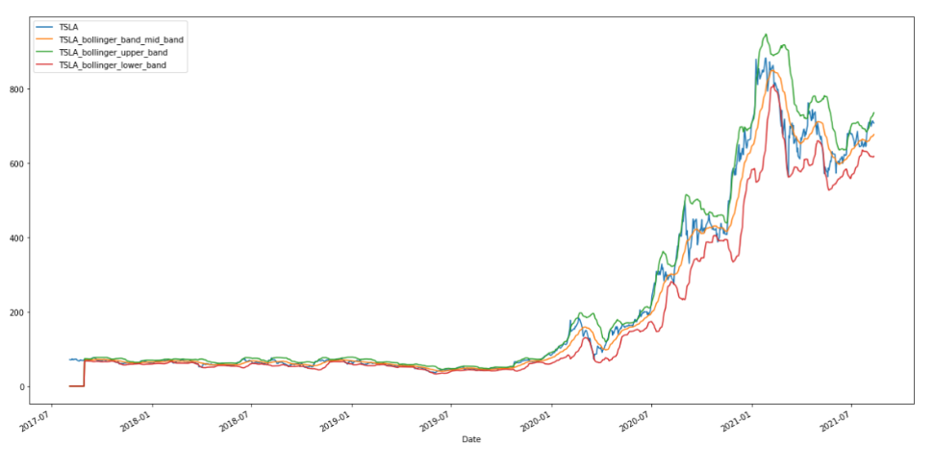
TRAINING THE DATA AND MODELS
RANDOM FOREST (4:8)
Here you can see the Bollinger upper, lower, and middle bands and what that “two standard deviations” looks like.
The results were similar across the automotive stocks. NOTE: the first 15 days are “0”.

Slide 27
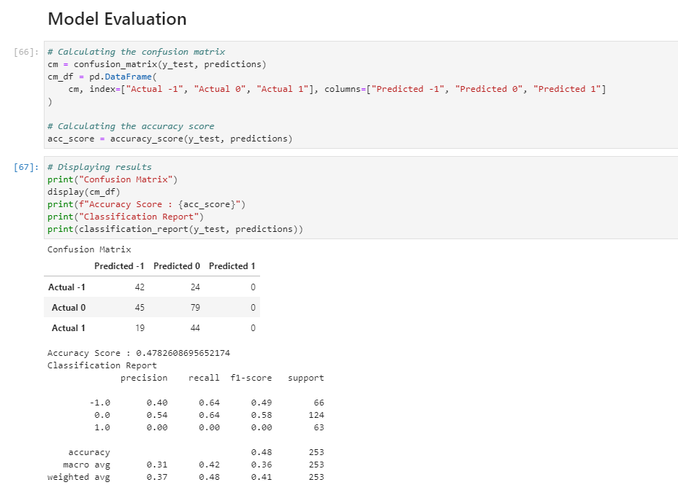
TRAINING THE DATA AND MODELS
RANDOM FOREST (5:8)
After using the Random Forest Model to test/train our features and run our predictive models, our confusion matrix were, initially, almost as confused as we were.
It seems like the features we used– the rolling average crossover points, the Bollinger curves, the views, etc., showed some importance, but weren’t ultimately very good price predictions. (next slide).

Slide 28
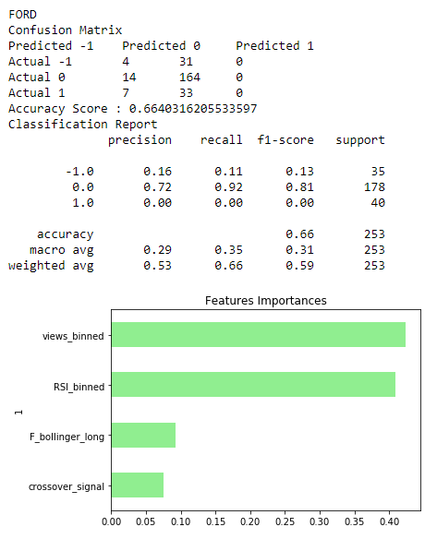
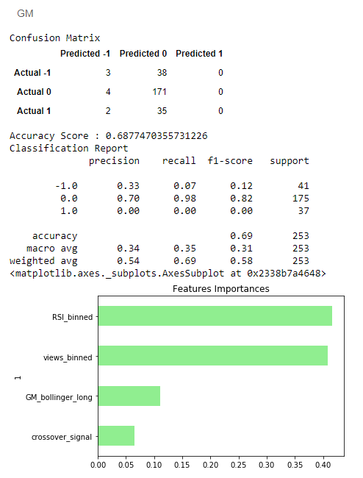
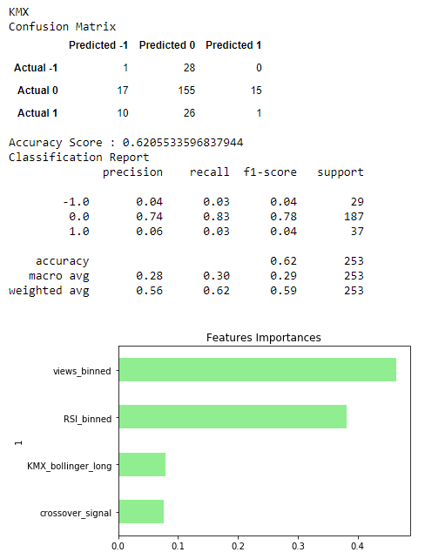
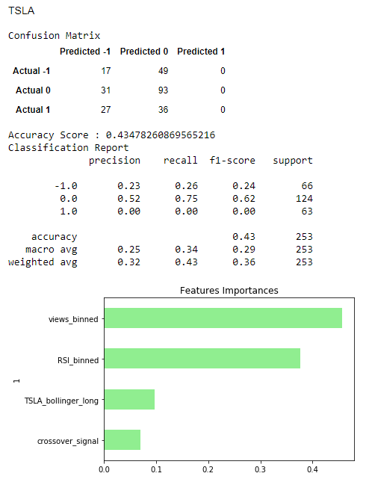
TRAINING THE DATA AND MODELS
RANDOM FOREST (6:8)

Slide 29
TRAINING THE DATA AND MODELS
RANDOM FOREST (7:8)
After adjusting the crossover days in the moving averages and correcting an error in the binning process we were able to refine the models to give us more sensible results (next table).
TRANSLATION: this was a more satisfying result than our previous conclusion, which would have been “Wikipedia Views are the primary driver of stock price action” and seemed wrong.

Slide 30
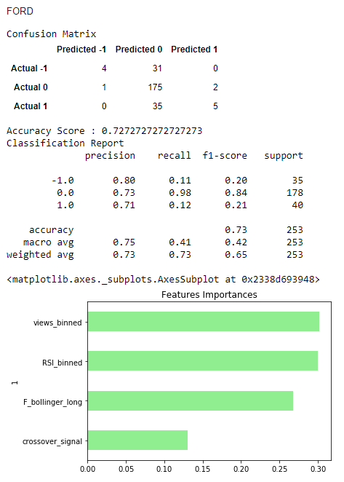
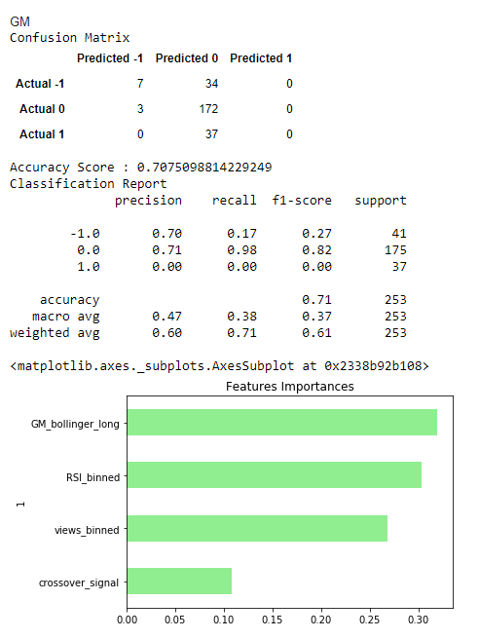
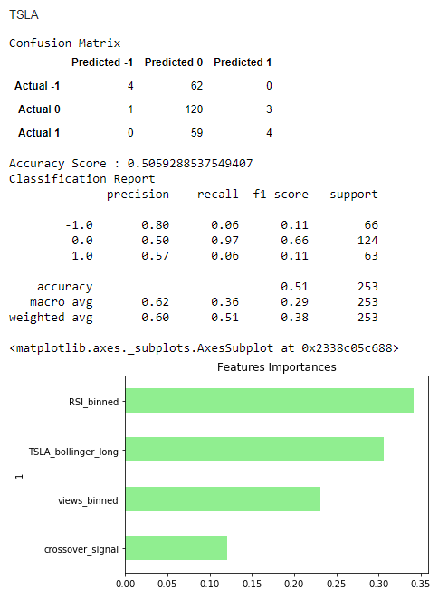
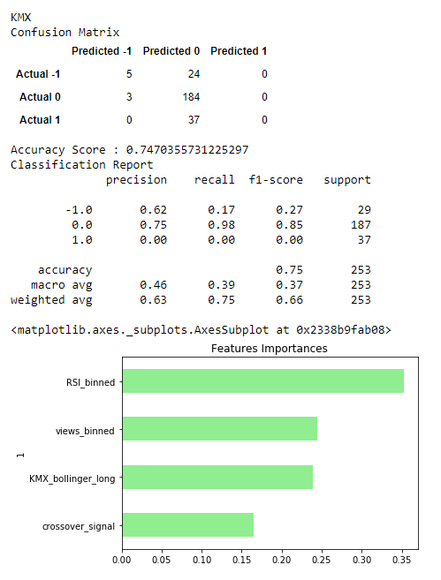
TRAINING THE DATA AND MODELS
RANDOM FOREST (8:8)

Slide 31
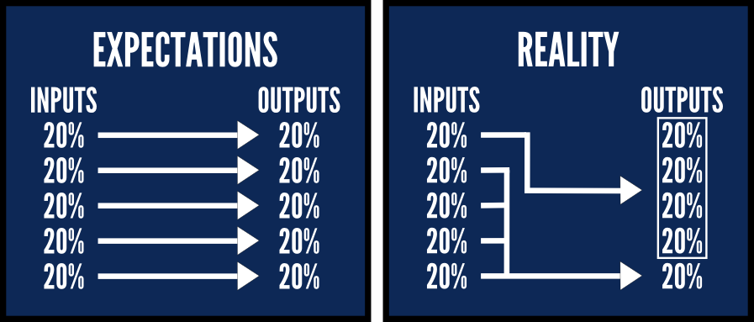
WHAT WE LEARNED
CONCLUSION
Our biggest lesson learned was that sourcing usable data can be a challenge. While data sources say API's are available, there is a wide range of quality that ranges from “useless and awful” to actually quite useful, and it’s not always obvious which is which.
Further, running deep learning models and tweaking features small amounts can add a lot to the accuracy of the model. We hear the phrase, “garbage in, garbage out”, and that’s very applicable here

Slide 32

JONATHAN BARAJAS // JO BORRAS // GENKI HIRAYAMA // VINCE PACILIO
MODULE 2 // GROUP 3

